Slide 1
WAN Concepts
CCNA Routing and Switching
Connecting Networks v6.0

Slide 2
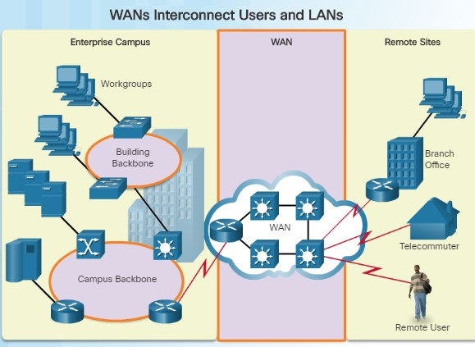
Purpose of WANs
Why a WAN?
A WAN operates beyond the geographic scope of a LAN.
WANs are used to interconnect the enterprise LAN to remote LANs in branch sites and telecommuter sites.
A WAN is owned by a service provider whereas a LAN is typically owned by an organization.
An organization must pay a fee to use the WAN service provider’s network services to connect remote sites.
Service providers provide links to interconnect remote sites for the purpose of transporting data, voice, and video.
2

Slide 3
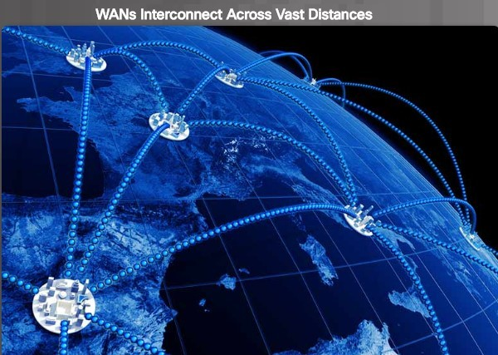
Purpose of WANs
Are WANs Necessary?
Without WANs, LANs would be a series of isolated networks.
As organizations expand, businesses require the ability to communicate between geographically separated sites. For example:
Regional or branch offices of an organization need to be able to communicate and share data with the central site.
Organizations need to share information with other customer organizations.
Employees who travel on company business frequently need to access the corporate network.
In addition, consumers now commonly communicate over the Internet with banks, stores, and other providers of goods and services.
2

Slide 4
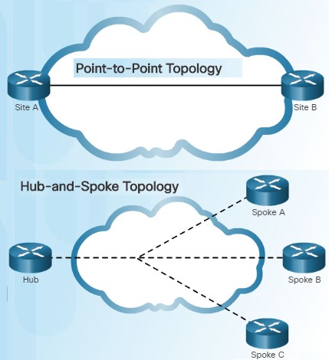
Purpose of WANs
WAN Topologies
Interconnecting multiple sites across WANs can involve a variety of service provider technologies and WAN topologies. There are four Common WAN topologies.
Point-to-Point topology
Employs a point-to-point circuit between two endpoints
Typically involves a dedicated leased-line connection
such as a T1/E1 line.
Transparent to the customer network and appears to be a direct physical link between two endpoints
Hub-and-Spoke
Applicable when a private network connection between multiple sites is required
A single interface to the hub can be shared by all spoke circuits.
Spoke sites can be interconnected through the hub site
using virtual circuits and routed subinterfaces at the
hub.
© 2016 Cisco and/or its affiliates. All rights reserved. Cisco Confidential 4

Slide 5
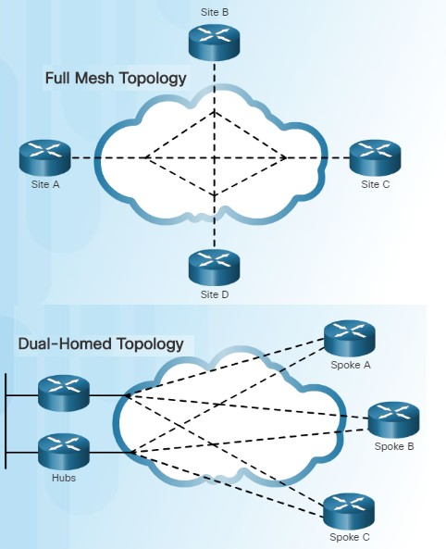
Purpose of WANs
WAN Topologies (Cont.)
Full Mesh
A disadvantage of the hub-and-spoke topology is that
all communication has to go through the hub.
With a full mesh topology using virtual circuits, any site can communicate directly with any other site.
A disadvantage is the large number of virtual circuits
that need to be configured and maintained.
Dual-homed Topology
Provides redundancy and load balancing however they are more expensive to implement than single- homed topologies.
Requires additional networking hardware including routers and switches.
More difficult to implement since they require complex configurations.
6

Slide 6
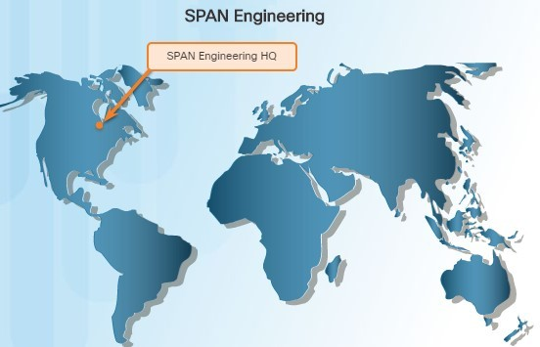
Purpose of WANs
Evolving Networks
In slow economic times, many businesses focus on increasing their profitability by improving the efficiency of their existing operations – including establishing and managing their network.
To justify such a large expense, many companies expect their networks to perform optimally and to be able to deliver an increasing array of services and applications to support productivity and profitability.
This chapter will focus on a fictitious company called SPAN Engineering.
This topic will illustrate how SPAN’s network requirements change as the company grows from a small, local business into a global enterprise.
6

Slide 7
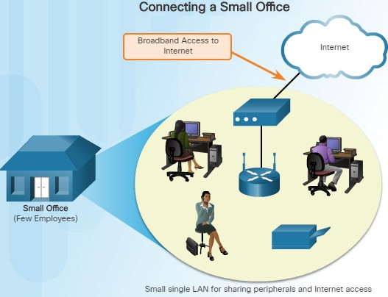
Purpose of WANs
Small Office
SPAN Engineering:
Environmental consulting firm (4 years)
Has developed a special process for converting household waste into electricity and is developing a small pilot project for a municipal government in its local area.
15 employees: six engineers, four computer-aided drawing (CAD) designers, a receptionist, two senior partners and two office assistants
Small office uses a single LAN to share information between computers, support their VoIP phones, share peripherals, printer, and large-scale plotter
Connects to the Internet using DSL
Uses support services purchased from DSL provider for IT support.
7

Slide 8
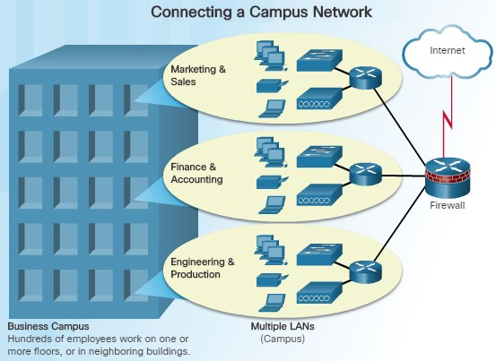
Purpose of WANs
Campus Network
Five years later, SPAN Engineering has grown rapidly. The company was contracted to design and implement a full-sized waste conversion facility as well as other projects in neighboring municipalities and around the country.
The company is now classified as a small to medium-sized business with several hundred employees.
The company now occupies multiple floors of an office building.
The network has grown to several subnetworks which spans several floors of the building.
The business now has an in-house IT staff to support and maintain the network.

Slide 9
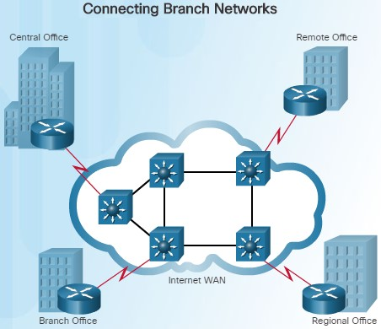
Purpose of WANs
Branch Networks
Another six years later, SPAN Engineering has been so successful, they have expanded their operation and have opened small branch offices closer to the project sites.
The company was required to implement a WAN in order for the remote sites to be able to access the data center which houses various databases and servers.
The branch offices that are in nearby cities use private dedicated lines through their local service provider.
Offices that are located in other countries must use the Internet for their WAN connection.

Slide 10
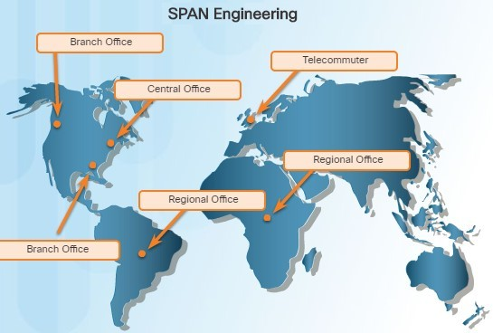
Purpose of WANs
Distributed Network
SPAN Engineering has now been in business for 20 years and has grown to thousands of employees distributed in offices worldwide.
The cost of the network and its related services is a significant expense.
To increase profitability, the company must reduce its operating expense.
What methods has the company used to reduce its operating costs?
To meet the new requirements, the network must provide the necessary converged service and secure Internet WAN connectivity to remote sites.
As seen in this example, network requirements of a company can change dramatically as a company grows over time.

Slide 11
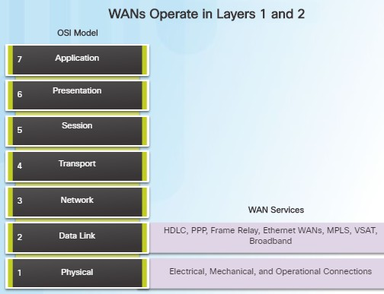
WAN Operations
WANs in the OSI Model
WAN operations focus primarily on the physical and data link layer of the OSI Model.
Data link layer requirements include physical addressing, flow control and encapsulation.
WAN access standards are defined and managed by a number of recognized authorities:
TIA/EIA (Telecommunications Industry Association and the Electronic Industries Alliance)
ISO (International Organization for Standardization)
IEEE (Institute of Electrical and Electronics Engineers)
Layer 1 protocols describe how to provide electrical, mechanical, operational, and functional connects to the services of a communications service provider.
Layer 2 protocols define how data is encapsulated and the mechanisms for transferring the resulting
frames.
© 2016 Cisco and/or its affiliates. All rights reserved. Cisco Confidential 11

Slide 12
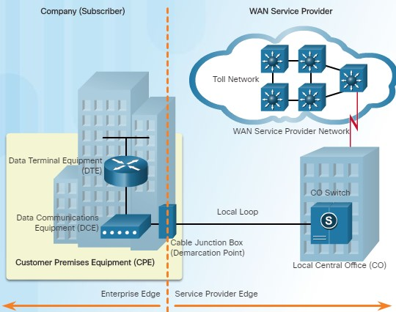
WAN Operations
Common WAN Terminology
One primary difference between a WAN and a LAN is that a company must subscribe to an outside WAN service provider to use WAN carrier network services.
Terminology commonly used to describe
WAN connections:
Customer Premises Equipment (CPE) – Consists of devices and inside wiring located on the enterprise edge connecting to a carrier
Data Communications Equipment (DCE) – Also called circuit-terminating equipment, the DCE consists of devices that put data on the local loop. The DCE primarily provides an interface to connect subscribers to a communication link on the WAN cloud.

Slide 13
WAN Operations
Common WAN Terminology (Cont.)
Data Terminal Equipment (DTE) – The customer devices that pass the data from a customer network or host computer for transmission over the WAN. The DTE connects to the local loop through the DCE.
Demarcation Point – This is a point established in a building to separate customer equipment from service provider equipment.
Local Loop (“last mile”) – The actual copper or fiber cable that connects the CPE to the CO of the service provider.
Central Office (CO) – The CO is the local service provider facility or building that connects the CPE to the provider network.
Toll network – This consists of the long-haul, all-digital, fiber-optic communications lines and other equipment inside the WAN provider network.

Slide 14
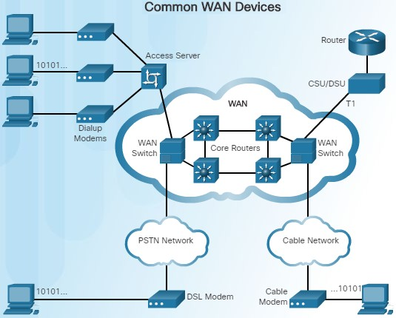
WAN Operations
WAN Devices
There are many types of devices that are
specific to WAN environments:
Dialup modem – Legacy WAN technology that converts (modulates) the digital signals produced by a computer into voice frequencies which are transmitted over the analog lines of the public telephone network to another modem for demodulation.
Access server – Legacy technology where the server controls and coordinates dialup modem, dial-in and dial-out user communications.
Broadband modem – A type of digital modem used with high-speed DSL or cable Internet service. Both operate in a similar manner to the voiceband modem, but use higher broadband frequencies and transmission speeds.

Slide 15
WAN Operations
WAN Devices (Cont.)
CSU/DSU - Digital-leased lines require a CSU and a DSU. The CSU provides termination for the digital signal and ensures connection integrity through error correction and line monitoring. The DSU converts line frames into frames that the LAN can interpret and vice versa.
Router – Provides internetworking and WAN access interface ports that are used to connect to the service provider.
Core router/Multilayer switch – A router or multilayer switch that resides within the middle or backbone of the WAN.

Slide 16
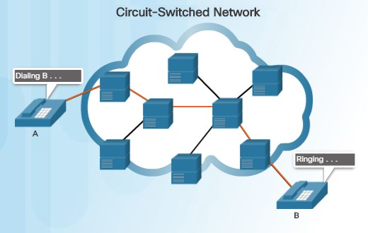
WAN Operations
Circuit Switching
A circuit-switched network is one that establishes a dedicated circuit (or channel) between nodes and terminals before the users may communicate.
Circuit switching dynamically establishes a dedicated virtual connection for voice or data between a sender and a receiver.
Communication can't start until the connection is established through the service provider network.
Dialing a number to make a call is an example of circuit switching technology.
The two most common types of circuit- switched WAN technologies are the public switched telephone network (PSTN) and the Integrated Services Digital Network (ISDN).

Slide 17
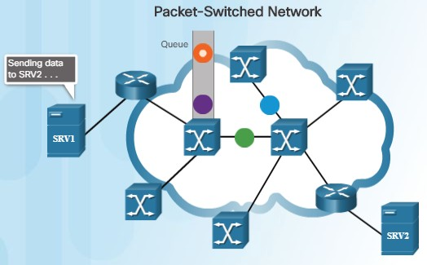
WAN Operations
Packet Switching
In contrast to circuit switching, packet switching splits traffic data into packets that are routed over a shared network.
A circuit does not need to be established and many pairs of nodes can communicate over the same channel.
There are two approaches to packet- switched network link determination:
Connectionless systems – Full addressing information must be carried in each packet. The Internet is an example of a connectionless system.
Connection-oriented systems – The network predetermines the route for a packet, and each packet only has to carry an identifier. An example of a connection-oriented system is Frame Relay (DLCIs are the identifiers).
Packet switching costs less than circuit switching, however, latency and jitter are greater in packet-switching networks.

Slide 18
Selecting a WAN Technology

Slide 19
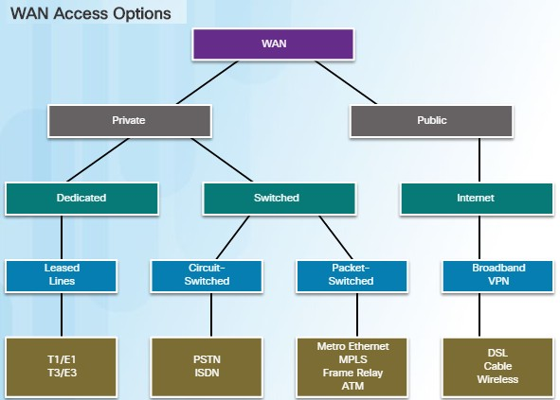
WAN Services
WAN Link Connection Options
There are several WAN access connection options that ISPs can use to connect the local loop to the enterprise edge.
Each option has distinct advantages and disadvantages as well as differences with technology, speed, and cost.
There are two ways an enterprise can obtain
WAN access:
Private WAN infrastructure – Choices may include dedicated point-to-point leased lines, circuit-switched links such as PSTN or ISDN, and packet switched links such as Ethernet WAN, ATM, or Frame Relay.
Public WAN infrastructure – Service providers may offer broadband Internet using DSL, cable, or satellite access. Data traveling between corporate sites over a public WAN should be protected using VPNs.

Slide 20
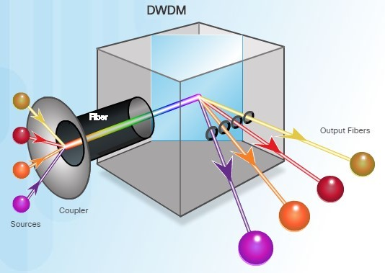
WAN Services
Service Provider Network Infrastructure
Service provider networks are complex and consist mostly of high-bandwidth fiber-optic media, using either Synchronous Optical Networking (SONET) or Synchronous Digital Hierarchy (SDH) standard.
A newer fiber-optic media development for long-range communications is called dense wavelength division multiplexing (DWDM).
Multiplies the amount of bandwidth that a single strand of fiber can support
Enables bidirectional communications over one strand of fiber
Can multiplex more than 80 different channels
of data onto a single fiber
Each channel can carry a 10 Gb/s multiplexed signal

Slide 21
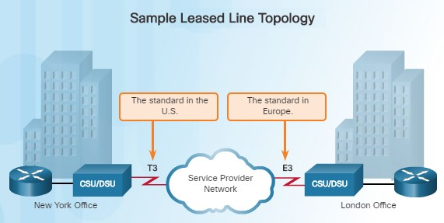
Private WAN Infrastructures
Leased Lines
Point-to-point lines are usually leased from a service provider and are called leased lines. However, since they have been around since the 1950s, they are sometimes referred to as:
Leased circuits
Serial link
Serial line
Point-to-point link
T1/E1 or T3/E3 lines
Leased lines vary in price depending on the bandwidth required and the distance between the two connected paths.
In North America, service providers use the T- carrier system to define the digital transmission capacity of a serial copper media link. For example, a T1 link supports
1.544 Mb/s.
When permanent dedicated connections are required, a point-to-point link is used to provide a pre-established WAN communications path from the customer premises to the provider network.
21

Slide 22
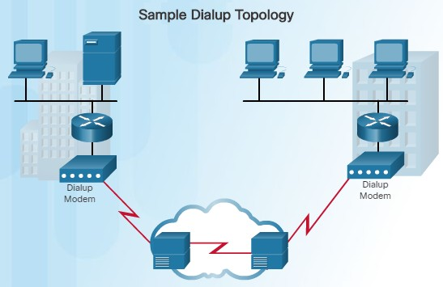
Private WAN Infrastructures
Dialup
Dialup WAN access may be required when no other WAN technology is available.
For example, a remote location could use modems and analog telephone lines to provide low capacity and dedicated switched connections.
Traditional local loops, which use copper cabling, transport binary computer data through the voice telephone network using a modem.
A modem modulates the binary data into an analog signal at the source and demodulates the analog signal to binary data at the destination.
The physical characteristics of the local loop and its connected to the PSTN limit the rate of the signal to less than 56 kb/s.
WAN built with an on demand connection using a modem
and the voice telephone network

Slide 23
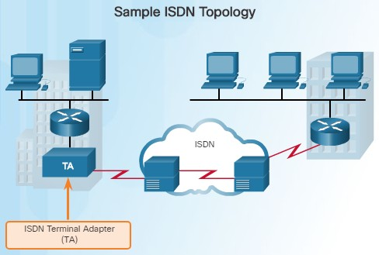
Private WAN Infrastructures
ISDN
Integrated Services Digital Network (ISDN) is a circuit-switching technology that enables the local loop of a PSTN to carry digital signals, resulting in higher capacity switched connections.
ISDN changes the internal connections of the PSTN from carrying analog signals to time-division multiplexed (TDM) digital signals.
TDM allows two or more signals, or bit streams, to be transferred as subchannels in one communication channel.
The ISDN connection may require a terminal adapter (TA) which is a device used to connect ISDN Basic Rate Interface (BRI) connections to a router.

Slide 24
Private WAN Infrastructures
ISDN (Cont.)
There are two types of ISDN Interfaces:
Basic Rate Interface (BRI) – ISDN BRI provides two 64 kb/s bearer channels (B) for carrying voice and data and a 16 kb/s delta channel (D) for signaling, call setup and other purposes.
Primary Rate Interface (PRI) – In North America, PRI delivers 23 B channels with 64 kb/s and one D channel with 64 kb/s for a total bit rate of up to
1.544 Mb/s. This includes some additional overhead for synchronization.
A common application of ISDN is to provide additional capacity as needed on a leased line connection. ISDN can also be used as a backup if the leased line fails.
Although ISDN is still an important technology for telephone service provider networks, it has declined in popularity due to DSL and other broadband services.

Slide 25
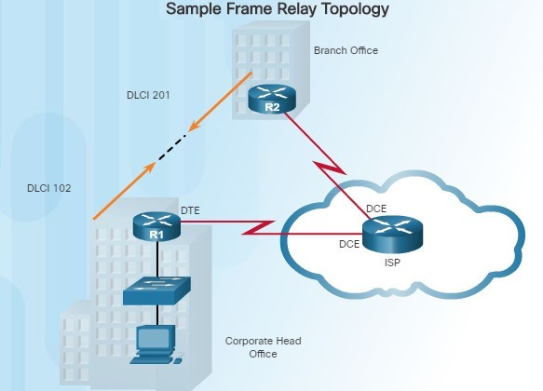
Private WAN Infrastructures
Frame Relay
Frame Relay is a Layer 2 non-broadcast multi-access (NBMA) WAN technology used to interconnect enterprise LANs.
Data rates of up to 4 Mb/s with some
providers offering higher rates
A single router can be used to connect multiple sites using PVCs which can carry both voice and data traffic.
An edge router only requires a single interface, even when multiple virtual circuits are used.
Frame Relay creates PVCs which are uniquely identified by a data-link connection identifier (DLCI). The PVCs and DLCIs ensure bidirectional communication between one DTE device to another.

Slide 26
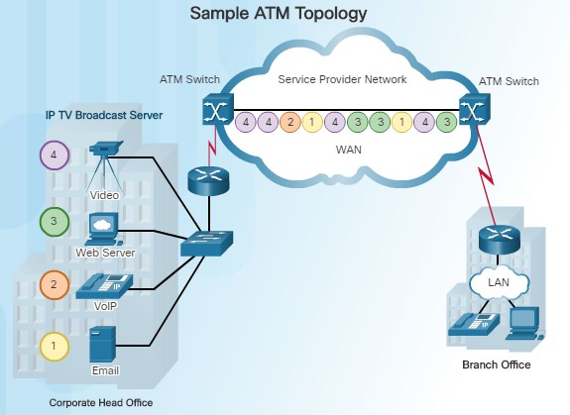
Private WAN Infrastructures
ATM
Asynchronous Transfer Mode (ATM) technology is capable of transferring voice, video, and data through private and public networks.
ATM is built on a cell-based architecture rather than on a frame-based architecture.
Cells are always a fixed length of 53 bytes.
ATM cells contain a 5-byte ATM header followed by 48 bytes of ATM payload.
Small fixed-length cells are well-suited for voice and video traffic.
A typical ATM line needs almost 20% greater bandwidth than Frame Relay to carry the same volume of network traffic.
When the cell is carrying segmented network layer traffic, the overhead is higher since the ATM switch must be able to reassemble the
packets at the destination.
© 2016 Cisco and/or its affiliates. All rights reserved. Cisco Confidential

Slide 27
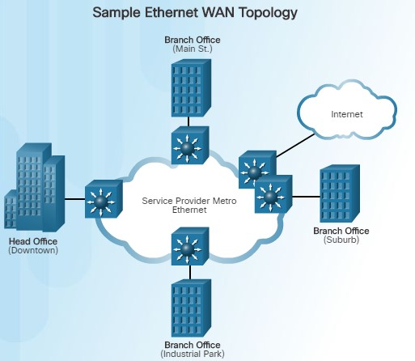
Private WAN Infrastructures
Ethernet WAN
Thanks to newer Ethernet standards using fiber-optic cables, Ethernet is now a reasonable WAN access option.
The original maximum cable length for
Ethernet was one kilometer.
With fiber-optic cable, the maximum length is 5 km using IEEE 10000Base-LX, and 70 km using IEEE 1000BASE-ZX standards.
Service providers now offer Ethernet WAN service using fiber-optic cabling which provide several benefits:
Reduced expenses and administration
Easy integration with existing networks
Enhanced business productivity
Ethernet WANs are commonly being used to replace Frame Relay and ATM WAN
links.

Slide 28
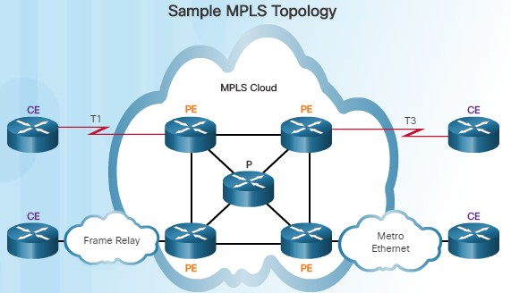
Private WAN Infrastructures
MPLS
Multiprotocol Label Switching (MPLS) is a multiprotocol high-performance WAN technology that directs data from one router to the next.
MPLS is based on short path labels rather
than IP network addresses.
It is called Multiprotocol since it has the ability to carry any payload including IPv4, IPv6, Ethernet, ATM, DSL, and Frame Relay traffic.
It uses labels which tell the router what to do
with a packet.
Notice in the figure to the left that different sites can connect to the MPLS cloud using different access technologies.
MPLS can support a wide range of WAN technologies including T-carrier / E-carrier links, Carrier Ethernet, ATM, Frame Relay,
MPLS is primarily a service provider WAN technology.
and DSL.

Slide 29
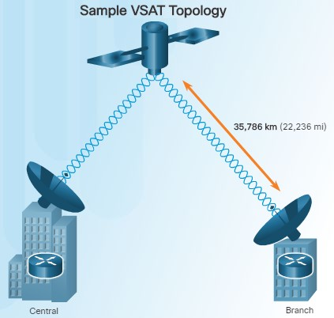
Private WAN Infrastructures
VSAT
All private WAN technologies discussed so far used either copper or fiber-optic media.
What if an organization needed connectivity in a remote location where there are no service providers that offer WAN service?
Very small aperture terminal (VSAT) is a solution that creates a private WAN using satellite communications.
A VSAT is a small satellite dish used to create a private WAN that provides connectivity to remote locations.
The satellite is in geosynchronous orbit in space. The signals travel approximately 35,786 kilometers to the satellite and back.
29

Slide 30
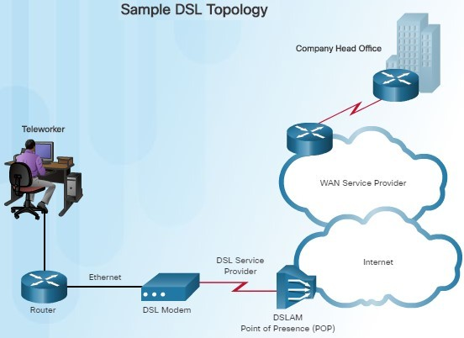
Public WAN Infrastructures
DSL
DSL is an always-on connection technology that uses existing twisted-pair telephone lines to transport high-bandwidth data, and provides IP services to subscribers.
A DSL modem is required which converts an Ethernet signal from the user device to a DSL signal, which is transmitted to the central office.
Multiple DSL subscriber lines are multiplexed into a single high-capacity link using a DSLAM at the provider location.
DSL is a popular choice for IT departments
to support home workers.
A subscriber must first connect to an ISP and then an IP connection is made through the Internet to the enterprise network.

Slide 31
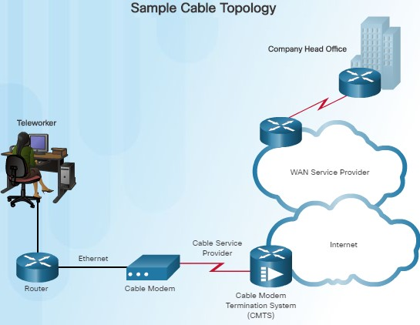
Public WAN Infrastructures
Cable
Network access is available from many cable television providers (using coaxial cable) which allows for greater bandwidth than the conventional telephone local loop.
Cable modems provide an always-on connection and a simple installation.
A subscriber connects a computer or a LAN router to the cable modem, which translates the digital signals into broadband frequencies used for transmitting on a cable television network.
The cable modem termination system (CMTS), which is a component located at the local cable TV office (headend), sends and receives digital cable modem signals on a cable network and is necessary for providing Internet services to subscribers.

Slide 32
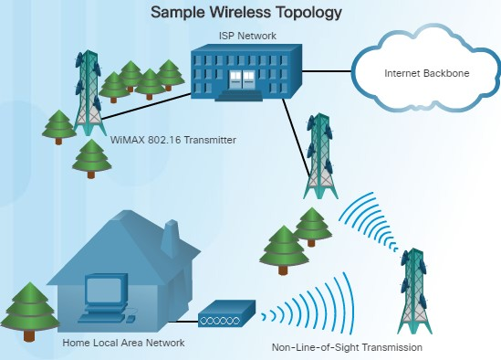
Public WAN Infrastructures
Wireless
Until recently, one limitation of wireless access has been the need to be within the local transmission range (typically less than 100 feet) of a wireless router or a wireless modem. The following new developments are changing this:
Municipal Wi-Fi – Many cities have begun setting up municipal wireless networks for free or for substantially less than broadband.
WiMAX (IEEE 802.16) – Worldwide Interoperability for Microwave Access (WiMAX) is a new high-speed broadband technology that is just beginning to come into use. WiMAX provides broad coverage similar to a cell phone network rather than through Wi-Fi hotspots. WiMAX operates similar to Wi-Fi, but at higher speeds and over longer distances.

Slide 33
Public WAN Infrastructures
Wireless (Cont.)
WiMAX uses a network of WiMAX towers that are similar to cell phone
towers. Subscribers must be within 30 miles of a tower.
Satellite Internet – Typically used by rural users where cable and DSL are not available. A VSAT provides two-way (upload and download) data communications. The upload speed is about one-tenth of the 500 kb/s download speed. Cable and DSL have higher download speeds, but satellite systems are about 10 times faster than analog modems.

Slide 34
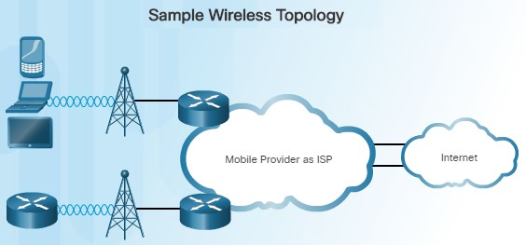
Public WAN Infrastructures
3G/4G Cellular
Increasingly, cellular service is another wireless WAN technology being used to connect users and remote locations where no other WAN access technology is available.
Phones, tablet computers, laptops, and even some routers can communicate through to the Internet using cellular technology.
These devices use radio waves to communicate through a nearby mobile phone tower. The device has a small radio antenna, and the provider has a much larger antenna sitting at the top of the tower somewhere within miles of the phone.
There are two common cellular industry terms:
3G/4G Wireless – Abbreviation for 3rd and 4th generation cellular access.
Long-Term Evolution (LTE) – Refers to a newer and faster technology and is considered to be part of the fourth generation (4G) technology.

Slide 35
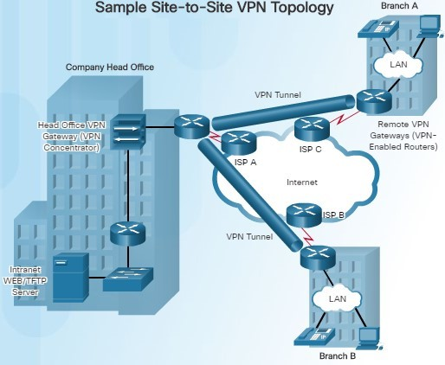
Public WAN Infrastructures
VPN Technology
Due to security risks, VPNs are needed when a teleworker or a remote office uses a broadband service to access the corporate WAN over the Internet.
A VPN is an encrypted connection between private networks over a public network, such as the Internet.
Instead of using a dedicated Layer 2 connection such as a leased line, a VPN uses virtual connections called VPN tunnels, which are routed through the Internet from the private network of the company to the remote site or employee host.

Slide 36
Public WAN Infrastructures
VPN Technology (Cont.)
There are several benefits to using VPNs:
Cost savings
Security
Scalability
Compatibility with broadband technology
There are two types of VPN access:
Site-to-site VPNs – Connects entire networks to each other; for example, they can connect a branch office network to a company headquarters network.
Remote-access VPNs – Enables telecommuters, mobile users, and extranet consumers to access a company network securely over the Internet.

Slide 37
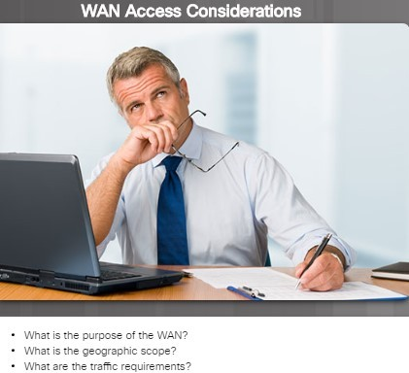
Selecting WAN Services
Choosing a WAN Link Connection
There are many factors to consider when choosing an appropriate WAN connection. Network administrators must answer numerous questions including:
What is the purpose of the WAN?
Will the enterprise connect local branches in the same city area, connect remote branches, or connect to a single branch?
Will the WAN be used to connect internal or external employees or customers?
What is the geographic scope?
Is the WAN local, regional, or global?
Is the WAN one-to-one (single branch), one-to-many branches, or many-to-many (distributed)?
What are the traffic requirements?
What type of traffic must be supported?
What are the quality and performance requirements?
What Quality of Service is required?

Slide 38
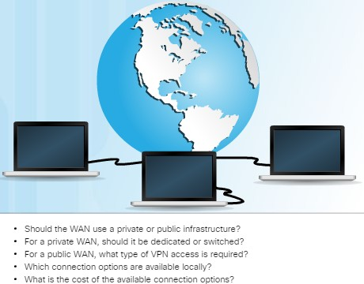
Selecting WAN Services
Choosing a WAN Link Connection (Cont.)
Should the WAN use private or public infrastructure?
Private infrastructure – offers the best security
Public Internet infrastructure – not as secure, but offers the most flexibility and lowest ongoing expense
For a private WAN, should it be dedicated or switched?
For a public WAN, what type of VPN access is required?
Which connection options are available
locally?
What are the costs of the connection options available?

Slide 39
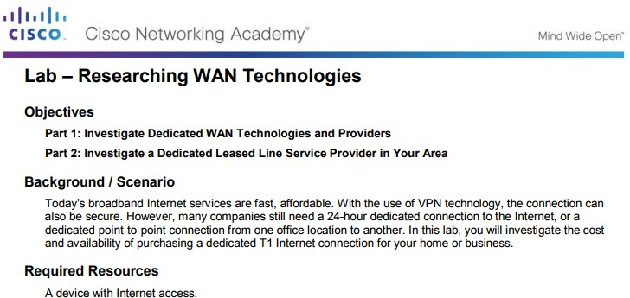
Selecting WAN Services
Lab – Researching WAN Technologies
In this lab, you will be required to investigate the cost and availability of purchasing a dedicated T1 Internet connection for your home or business.

Slide 40
Conclusion
Summary
1.1 WAN Technologies Overview
Explain WAN access technologies available to small to medium-sized business networks.
Explain the purpose of a WAN.
Explain how WANs operate.
1.2 Selecting a WAN Technology
Select WAN access technologies to satisfy business requirements.
Describe WAN services available.
Compare private WAN technologies.
Compare public WAN technologies.
Select the appropriate WAN protocol and service for a specific network requirement.

